Slide 1



Sorting
Swati Mali
swatimali@somaiya.edu

Slide 2
Outline
Sorting- concept
Sorting Terms
Bubble sort
Insertion sort
Counting sort
Sorting applications

Slide 3
Sorting
Sorting is any process of arranging items systematically in a particular order
Sorting in ascending order :arrange n keys in such a way that key_{i}< key_{j} for any i & j such that i<j
Sorting in descending order: arrange n keys in such a way that key_{i} > key_{j} for any i & j any i & j such that i<j

Slide 4
Sorting Terms
Stable sort
Inplace sort
Number of Passes

Slide 5
Bubble Sort
Compares adjacent array elements
Exchanges their values if they are out of order
Smaller values bubble up to the top of the array
Larger values sink to the bottom

Slide 6
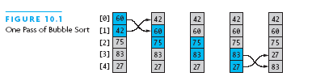
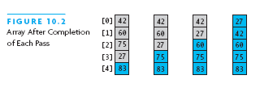
Bubble Sort Example

Slide 7
Bubble Sort Algorithm
do
for each pair of adjacent array elements
if values are out of order
Exchange the values
while the array is not sorted

Slide 8
Bubble Sort Algorithm, Refined
do
Initialize exchanges to false
for each pair of adjacent array elements
if values are out of order
Exchange the values
Set exchanges to true
while exchanges

Slide 9
Analysis of Bubble Sort
Excellent performance in some cases
But very poor performance in others!
Works best when array is nearly sorted to begin with
Worst case number of comparisons: O(n²)
Worst case number of exchanges: O(n²)
Best case occurs when the array is already sorted:
O(n) comparisons
O(1) exchanges (none actually)

Slide 10
bubbleSort(int arr[], int n)
{
int i, j;
for (i = 0; i < n-1; i++)
// Last i elements are already in place
for (j = 0; j < n-i-1; j++)
if (arr[j] > arr[j+1])
swap(&arr[j], &arr[j+1]);
}

Slide 11
Bubble Sort Code
int pass = 1;
boolean exchanges;
do {
exchanges = false;
for (int i = 0; i < a.length-pass; i++)
if (a[i].compareTo(a[i+1]) > 0) {
tmp = a[i];
a[i] = a[i+1];
a[i+1] = tmp;
exchanges = true;
}
pass++;
} while (exchanges);

Slide 12
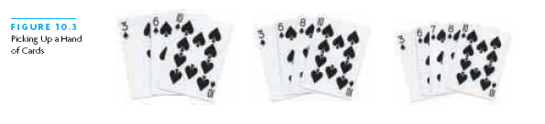
Insertion Sort
Based on technique of card players to arrange a hand
Player keeps cards picked up so far in sorted order
When the player picks up a new card
Makes room for the new card
Then inserts it in its proper place

Slide 13
Insertion sort algorithm
INSERTION_SORT takes as parameters an array A[1.. n] and the length n of the array. The array A is sorted in place: the numbers are rearranged within the array, with at most a constant number outside the array at any time.
INSERTION_SORT (A)
1. FOR j ← 2 TO length[A] 2. DO key ← A[j] 3. {Put A[j] into the sorted sequence A[1 . . j − 1]} 4. i ← j − 1 5. WHILE i > 0 and A[i] > key 6. DO A[i +1] ← A[i] 7. i ← i − 1 8. A[i + 1] ← key

Slide 14
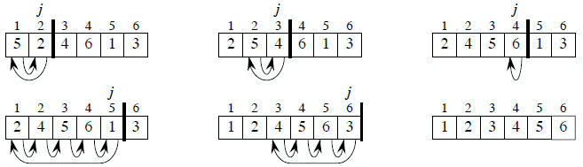
Insertion sort algorithm
Stability :
Since multiple keys with the same value are placed in the sorted array in the same order that they appear in the input array, Insertion sort is stable.
Courtesy: Analysis of Algorithm, Coreman

Slide 15
Counting sort
sorting is based on keys between a specific range.
It works by counting the number of objects having distinct key values
Followed by computation of position of each object in the output sequence.

Slide 16
Counting sort
Initialize count array of the size of input range
Update the count array to store the count of each unique key.
Further update the count array with cumulative additions of previous counts
Shift the count array to right by one position; no circular shift
Initialize sort array of the size of input sequence
Update sort array by entering keys from input array at location from count array and increment the count by 1

Slide 17
Counting sort example
i/p : 2 3 1 2 4 5 2 1 5 4
N= 10, range: 1:5
Initialize count array of the size of input range
count array | 0 | 1 | 2 | 3 | 4 | 5
 | 0 | 0 | 0 | 0 | 0 | 0
Update the count array to store the count of each unique key.
count array | 0 | 1 | 2 | 3 | 4 | 5
 | 0 | 2 | 3 | 1 | 2 | 2
Further update the count array with cumulative additions of previous counts
count array | 0 | 1 | 2 | 3 | 4 | 5
 | 0 | 2 | 5 | 6 | 8 | 10
Shift the count array to right by one position; no circular shift
count array | 0 | 1 | 2 | 3 | 4 | 5
 | 0 | 0 | 2 | 5 | 6 | 8

Slide 18
Initialize sort array of the size of input sequence
Sort Array | 0 | 1 | 2 | 3 | 4 | 5 | 6 | 7 | 8 | 9
Update sort array by entering keys from input array at location from count array and increment the count by 1
i/p | 2 | 3 | 1 | 2 | 4 | 5 | 2 | 1 | 5 | 4
count array | 0 | 1 | 2 | 3 | 4 | 5
 | 0 | 2 | 5 | 6 | 7 | 10
Output Sorted Array | 0 | 1 | 2 | 3 | 4 | 5 | 6 | 7 | 8 | 9
 | 1 | 1 | 2 | 2 | 2 | 3 | 4 | 4 | 5 | 5

Slide 19
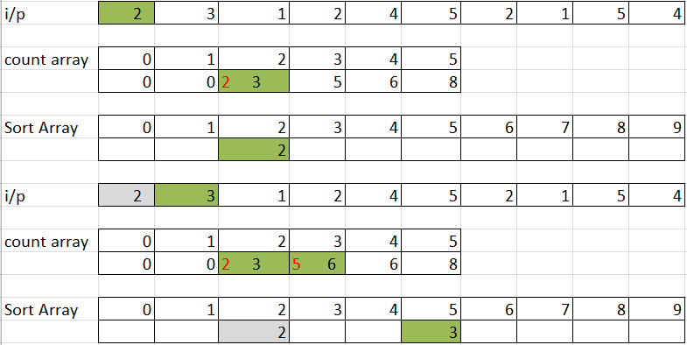
Counting sort step by step

Slide 20
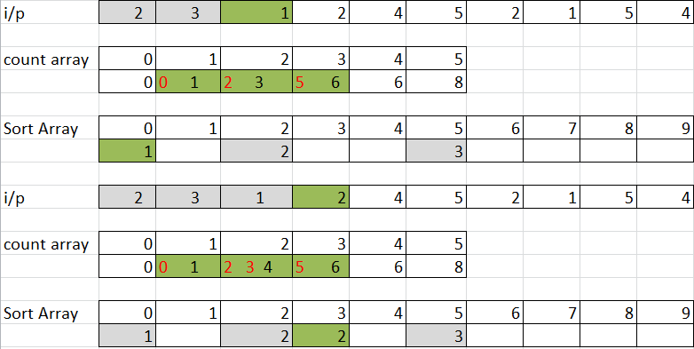
Counting sort step by step

Slide 21
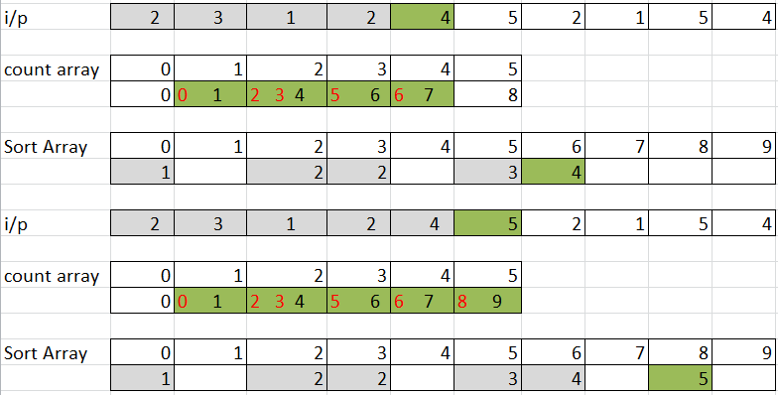
Counting sort step by step

Slide 22
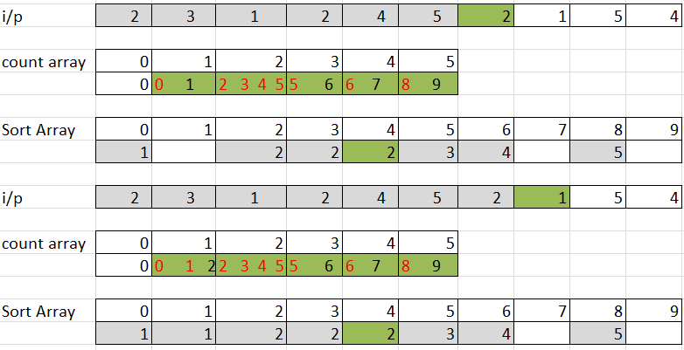
Counting sort step by step

Slide 23
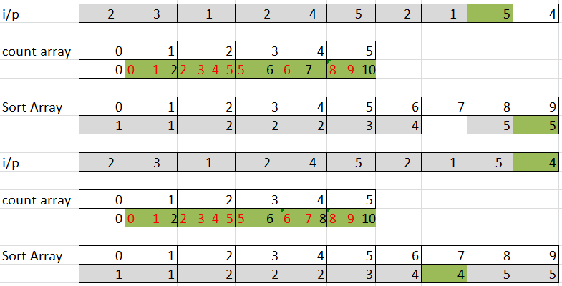
Counting sort step by step

Slide 24
Analysis of sorting algorithms
Sr. no. | Algorithm | Stable? | Inplace? | #passes?
1 | Bubble
2 | Insertion
3 | Counting

Slide 25
Thank you

